Slide 1


Synopsis Presentation on Lost & Found Person
Guided By: Presented By:
Prof. (Dr.) Nitin Kulkarni Atharv Sharma
Khushi Agrawal
Harshita Sultanpura
Dali Vaishnav

Slide 2
Contents
Introduction
1.1 Overview
1.2 Purpose
Literature Review
Problem Statement
Proposed Solution
Objectives
Theoretical Analysis
6.1 Block Diagram
6.2 Hardware Requirements
6.3 Software Requirements
Applications
8. References

Slide 3
1. Introduction
1.1 Overview
An AI-powered digital platform designed to help locate missing persons and recover lost belongings.
Bridges the gap between the public, law-enforcement agencies, and reporting individuals through a single, centralized system.
Uses facial recognition, object detection, and geolocation services to match new reports with existing data in real time.
Provides a secure, user-friendly interface for reporting, searching, and tracking incidents.
1.2 Purpose
Centralized Reporting: Offer one reliable platform for quick submission of missing-person or lost-item cases.
Real-Time Alerts: Send instant notifications and location updates to nearby users and authorities, ensuring faster action.
Community Participation: Encourage the public to assist by sharing sightings and matching reports, strengthening civic safety.

Slide 4
2. Literature Review
Summary of Solutions/Systems already available that are addressing the same issue/problem.
Sr. No. | Name of Solution/System | Features | Limitations/ Drawbacks
1. | Manual FIR & Posters | Official police reports and printed flyers to inform the public. | Slow, location-bound, limited reach, prone to human error.
2. | Social Media Campaigns | Rapid, wide online visibility through platforms like Facebook, X, and WhatsApp. | Data scattered across channels, no verification, and no real-time matching.
3. | Basic Lost & Found Apps / Web Portals | Allow users to submit reports with photos and descriptions. | Lack AI for facial or object recognition, minimal alert mechanisms, and poor integration with authorities.

Slide 5
3. Problem Statement
Many individuals face delays and low success rates when trying to locate missing persons or recover lost belongings. The key issues include:
Fragmented Reporting: Information is scattered across police FIRs, social media posts, and informal networks, making it hard to consolidate cases.
Manual & Slow Searches: Traditional posters, announcements, and word-of-mouth methods are time-consuming and have limited reach.
Lack of Intelligent Matching: Most existing systems do not use facial recognition or object detection, causing missed connections and lower recovery rates.
No Real-Time Alerts: There is no unified platform to instantly notify nearby users or authorities when a match is found.

Slide 6
4. Proposed Solution
The proposed solution is to develop a centralized AI-powered platform for tracking missing persons and lost items that incorporates the following features:
Unified Reporting System: Web and mobile application where users can register missing persons or lost belongings with photos, descriptions, and last-known locations.
AI-Based Smart Matching: Facial recognition for identifying missing individuals and object detection/classification for lost items to automatically compare new and existing reports.
Real-Time Geo-Alerts: Integration with Google Maps API and Firebase/Twilio to send instant, location-based notifications to nearby users and authorities when a probable match is found.
Role-Based Access & Verification: Dedicated dashboards for police, NGOs, or administrators to review, validate, and close cases securely.

Slide 7
5. Objectives
Centralized Reporting: Provide a single platform to quickly register missing persons and lost items with images, descriptions, and location details.
AI-Driven Matching: Use facial recognition and object detection to automatically identify potential matches between reports.
Real-Time Alerts: Send instant, location-based notifications to nearby users and relevant authorities for faster recovery.
Community Participation: Encourage the public to submit sightings and assist in tracking, creating a strong support network.
Secure & Scalable System: Ensure encrypted data handling and a modular architecture that can be deployed across cities, events, and institutions.

Slide 8
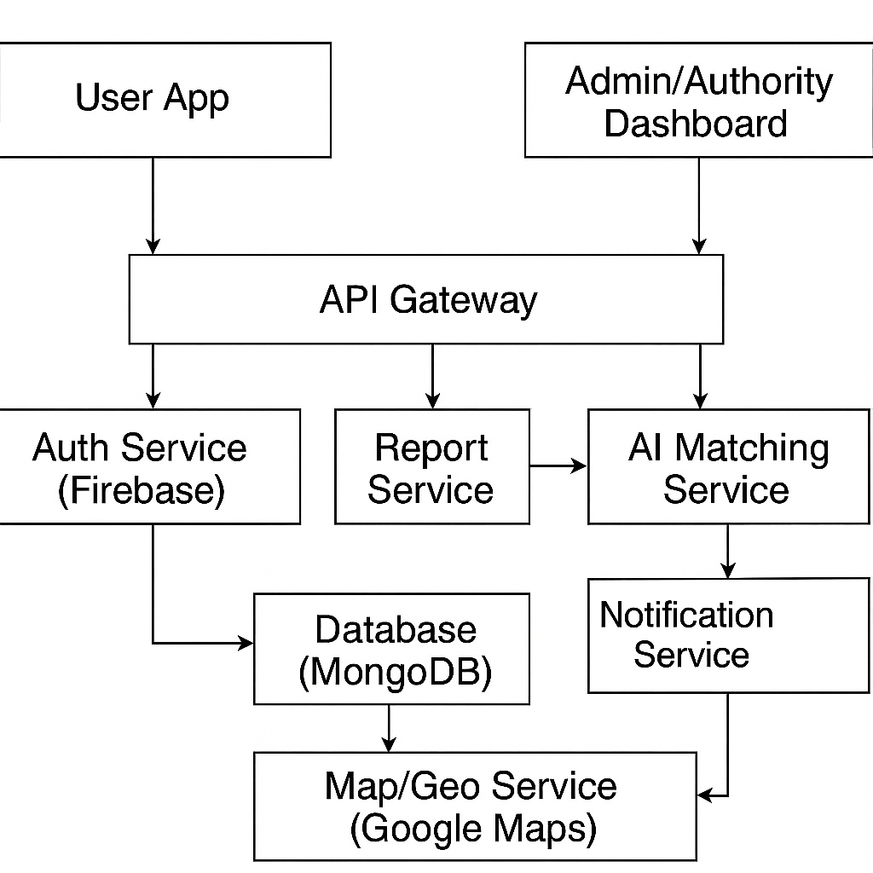
6. Theoretical Analysis
6.1 Block Diagram

Slide 9
6. Theoretical Analysis
6.2 Hardware Requirements:
Server/Cloud Hosting: A server or cloud hosting service to manage the application and handle data processing
User Devices: PCs, tablets, or smartphones for users to access the system.
6.3 Software Requirements:
Languages: Python 3.10, Java JDK 17.
AI/ML & Libraries: TensorFlow 2.13.0, OpenCV 4.8.0, scikit-learn 1.3.0, Pandas 2.0.3, NumPy 1.25.2.
Frontend: ReactJS 18.2.0 (or Flutter 3.10.5).
Backend: Spring Boot 3.1.2 (Java).
Databases: MongoDB 6.0 (primary, NoSQL)
APIs/Services: Google Maps API (geolocation), Firebase (Auth, Realtime DB, Cloud Messaging), Twilio API (SMS alerts).

Slide 10
Applications
Law Enforcement & Police Departments – Rapid reporting, tracking, and verification of missing person cases; automated match detection and public alerts.
Hospitals & Care Homes – Helps locate elderly or mentally challenged individuals who may wander or get separated.
Schools, Colleges & Hostels – Assists in recovering lost student belongings and managing missing-student alerts during trips or events.
Airports, Railway & Bus Terminals – Tracks unclaimed baggage, lost documents, and missing persons in busy transit hubs.
Large Public Events & Festivals – Provides real-time alerts and recovery of lost items or children in crowded gatherings.
Corporate & Commercial Buildings – Internal lost-and-found management for employees and visitors.
Smart-City & Civic Safety Networks – Can be integrated with municipal safety apps to strengthen urban security infrastructure.

Slide 11
GitHub Link
https://github.com/Atharv9406/Lost-Found-Person

Slide 12
REFERENCES
Google Maps API Documentation – https://developers.google.com/maps/documentation
OpenCV Documentation – https://docs.opencv.org/master/
Firebase Cloud Messaging (FCM) Docs – https://firebase.google.com/docs/cloud-messaging
Twilio Messaging API – https://www.twilio.com/docs/messaging
Face Recognition Using Deep Learning: A Review – IEEE Xplore – https://ieeexplore.ieee.org/document/9449828
Kaggle – Missing Person Data Sets – https://www.kaggle.com/datasets/iamsouravbanerjee/missing-persons-dataset
TensorFlow Documentation – https://www.tensorflow.org/
Pandas Documentation (Data Preprocessing) – https://pandas.pydata.org/docs/
MongoDB Official Docs – https://www.mongodb.com/docs/
Real-Life Missing Persons Statistics – NCRB India – https://ncrb.gov.in/en/crime-india

Slide 13
Thank You
Queries ?

